Slide 1
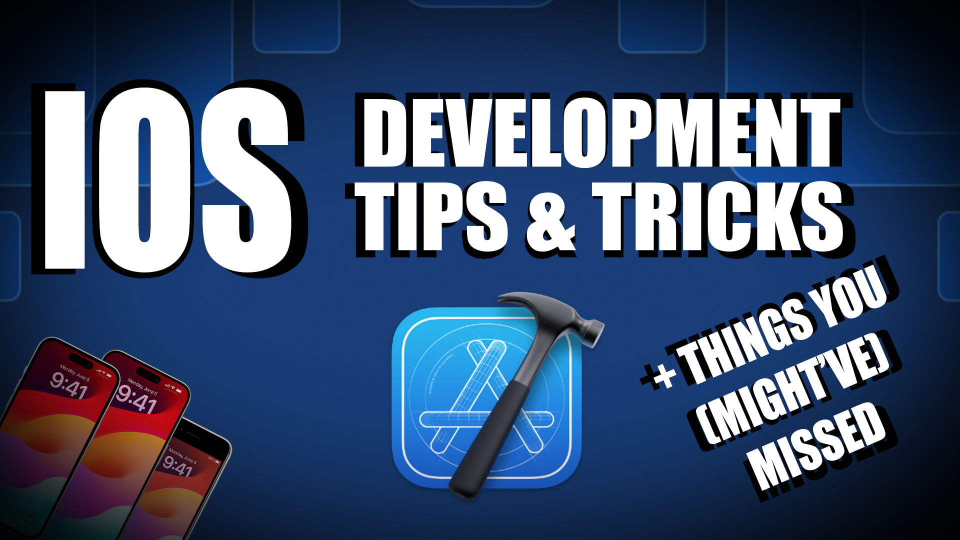

Slide 2
About Me
Professional software developer since 1988
Co-founded the mobile development practice at Object Partners in 2010
Principle iOS Engineer at CVS Health since January 2024
14 years of experience in iOS development, some experience in Android and cross-platform application development.

Slide 3


Slide 4
import StandardDisclaimers
All views expressed here are my own. I do not speak for or represent CVS Health in any capacity.
Workflow is a highly personal thing. Mine happens to be fairly terminal centric, which may not work for everyone. If a GUI based tool or some other utility works better for you, definitely use that!
Share your finds a gems with others. I’m always happy to hear about new tools and utilities for development!

Slide 5
Package Management & Installation
Homebrew - Package manager for MacOS. https://brew.sh/
Dump all current apps to Brewfile: brew bundle dump
Install from Brewfile in current directory : brew bundle
Mas – Command line interface for the AppStore. https://github.com/mas-cli/mas
brew install mas
mas install 1289583905 # Pixelmator Pro
Combining these utilities allow for scripting configuration and (re)installation of a system (configuration as code). Use github private repo to manage the script(s).

Slide 6
Package Management & Installation
Unexplored: Dotfiles Projects
Managing dotfile configuration as code. (.zshrc, .gitconfig, etc)
Of particular interest: .macos files – macOS default configuration from the command line.
https://github.com/driesvints/dotfiles?tab=readme-ov-file
https://github.com/mathiasbynens/dotfiles
https://github.com/kevinSuttle/MacOS-Defaults

Slide 7
Core Utilities – iTerm2
Enhanced & configurable terminal for macOS. https://iterm2.com/
brew install iterm2
Split Panes – vertical (⌘ ⇧D) & horizontal (⌘D)
Tabs – ⌘T
Search - ⌘F
Autocomplete – start typing then press ⌘; (the word has have appeared in the current terminal session)
Sensible copy and paste – select with mouse, ⌘C ⌘V
More: https://iterm2.com/features.html

Slide 8
Core Utilities – Oh My ZSH!
Open source framework for ZSH configuration that provides thousands of functions, helpers, plugins and themes. https://ohmyz.sh/
sh -c "$(curl -fsSL https://raw.githubusercontent.com/ohmyzsh/ohmyzsh/master/tools/install.sh)"
Recommended plugins: git, brew, macos, rvm, xcode
gpsup = git push –set-upstream origin <current branch>
xc = open any Xcode project, workspace or Package.swift in the current directory
xcdd = clear the Xcode Derived Data folder
Plugin List: https://github.com/ohmyzsh/ohmyzsh/wiki/Plugins

Slide 9


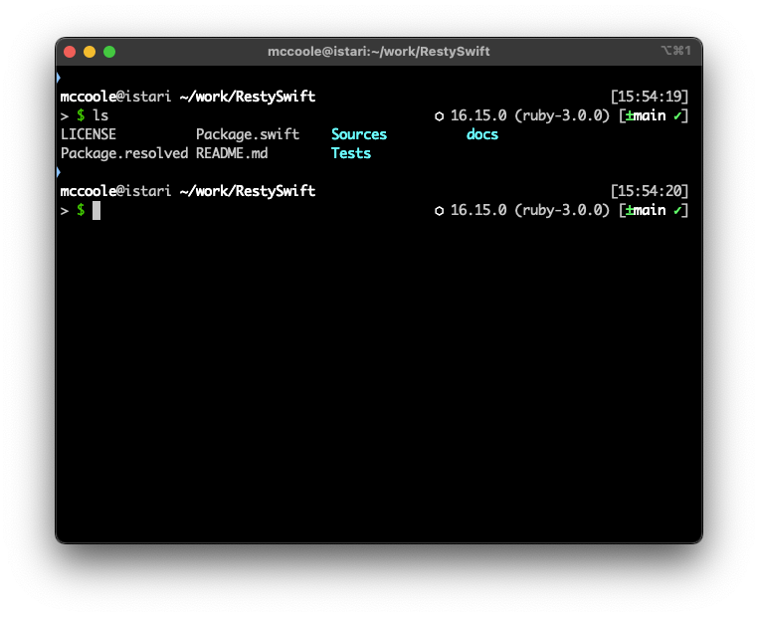
Core Utilities – Oh My ZSH!
Theme: bureau
User, machine name, path and current time
Prompt
For the current directory
NVM node version
RVM ruby version
Git status: branch, out of date, untracked files

Slide 10
libimobiledevice
A “cross-platform protocol library to communicate with iOS devices”. So… what does that mean? https://github.com/libimobiledevice/libimobiledevice
What is of most interest are the utilities that come with it that use the library to perform low level operations with a connected iOS device from the command line.
brew install libimobiledevice
List of utilities: https://github.com/libimobiledevice/libimobiledevice?tab=readme-ov-file#utilities

Slide 11
libimobiledevice
idevice_id : List attached devices or print device name of given device
idevicebackup2 : Create or restore backups for devices running iOS 4 or later
idevicecrashreport : Get crash reports from a device
idevicediagnostics : Interact with the diagnostics interface of a device.
idevicediagnostics restart will perform a cold reboot of a device. Can also specify shutdown and sleep.
ideviceinfo: Show information about a connected device.
idevicescreenshot: Gets a screenshot from the connected device.
More… See the link previously for the list on github. The version installed with homebrew does not come with all the command line utilities sadly. ☹

Slide 12
idevicelocation
Allows you to set and reset the location for connected iOS devices from the command line. https://github.com/JonGabilondoAngulo/idevicelocation
Sadly, not on Homebrew. Building instructions: https://gist.github.com/opi-smccoole/ec09cab95b6125f862a5656fd4094fce
Great for location testing on device instead of Xcode targets or gpx files
idevicesetlocation -- 33.67861 -118.00073 LA
idevicesetlocation -- -37.8575 175.679722 Hobbiton Set LOTR NZ
idevicesetlocation reset Reset the device to use the GPS Radio

Slide 13
Tying Things Together For Command Line
I use several zsh aliases and functions to tie things together and minimize typing of long commands and arguments.
These aliases are available in this gist: https://gist.github.com/opi-smccoole/4ed495ffa9e254814fe9baf1a878ddfd#file-ios_dev_aliases-txt
Will do a very fast run-through at the end

Slide 14
XCODE shortcuts/hints
Closing multiple folders at once:
Highlight all to close and press left arrow.
Option-Close on a folder will close it and all its descendants at once.
Command-Close (click chevron) on a folder will close it and all its siblings at once.
Command-B – build
Command-Shift-K – clean
Command-Shift-O – open quickly, search for files, symbols, etc.
More: https://www.hackingwithswift.com/articles/229/24-quick-xcode-tips

Slide 15
SwiftGen
SwiftGen is a tool to automatically generate Swift code for resources of your projects (like images, localized strings, fonts, colors, ib files, JSON files, etc.), to make them type-safe to use. https://github.com/SwiftGen/SwiftGen
Install via SPM in the project or via Homebrew with brew install swiftgen
Integrate differently depending how you install it. Will elaborate more later.
Newer versions of Xcode do some of this (Images & Colors) but not all. This feature has to be disabled so that it doesn’t conflict with SwiftGen. Will show how this is done with XcodeGen.
Configured by a yaml file, usually swiftgen.yml, and set to run as a pre-compile step when you build the project.
Does not support the built in SFSymbols from Apple but another small library does: https://github.com/SFSafeSymbols/SFSafeSymbols
We will look at a small example and see how it is configured and integrated.

Slide 16
SwiftLint
A tool to enforce Swift style and conventions. https://github.com/realm/SwiftLint
Install in project with SPM or with Homebrew. brew install swiftlint
Integrate differently depending on how you install it. Runs as a post compile step.
Configure with… yep, a yaml file! Default looks for .swiftlint.yml (Yes, it’s a dot file, yes that makes it pain. Can change it but usually don’t bother.)
Good default style configuration starter from Kodeco (raywenderlich.com) https://github.com/kodecocodes/swift-style-guide/blob/main/com.raywenderlich.swiftlint.yml
Rule & configuration documentation: https://realm.github.io/SwiftLint/index.html

Slide 17
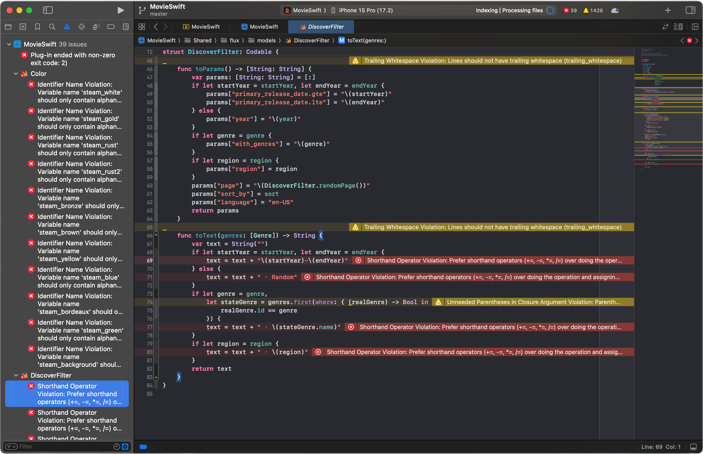

Slide 18
XcodeGen
Generates Xcode project files (project.pbxproj) from the file system and a yaml or json configuration file. https://github.com/yonaskolb/XcodeGen
Install from Homebrew: brew install xcodegen
Extensive configuration documentation: https://github.com/yonaskolb/XcodeGen/blob/master/Docs/ProjectSpec.md
I consider this, or a utility like it (Tuist, Bazel, etc.) as very beneficial to personal projects and essential to large scale projects with many developers. Why?

Slide 19
Why XcodeGen?
The Xcode project file (AppName.xcodeproj/project.pbxproj) is exceptionally opaque XML that tracks the contents of the entire project (files, groups, etc) so it is easy to get conflicts when merging or rebasing branches. Resolving these conflicts is particularly complex and time consuming.
This can happen in individual projects if you have several features branches under development at the same time and is significantly more likely with each additional developer.
XcodeGen can also help with other complex tasks like renaming an Xcode project. With XcodeGen you can edit the project.yml and Info.plist files, change the folder names and run xcodegen. Contrast this with the manual steps: https://gist.github.com/opi-smccoole/68a4799c6ef97cea9a7237e00de63814#file-renamingxcodeprojects-md

Slide 20
Using XcodeGen
There are a few gotchas in setup with the newer project formats and defaults in Xcode 15 like Info.plist “syncing” and disabling Image and Color type generation for SwiftGen. Will walk through an example project.yml configuration file at the end.
Once set up, you remove AppName.xcodeproj and add it to your .gitignore file so you do not check it into source code control.
When you clone the repository for the first time you run xcodegen generate to create the project file, which you can then open with Xcode.
When you check out a new branch or pull updates from your source code control repository you also run xcodegen generate to update the project file.
Small (very contrived) configuration file walkthrough and demo at the end.

Slide 21
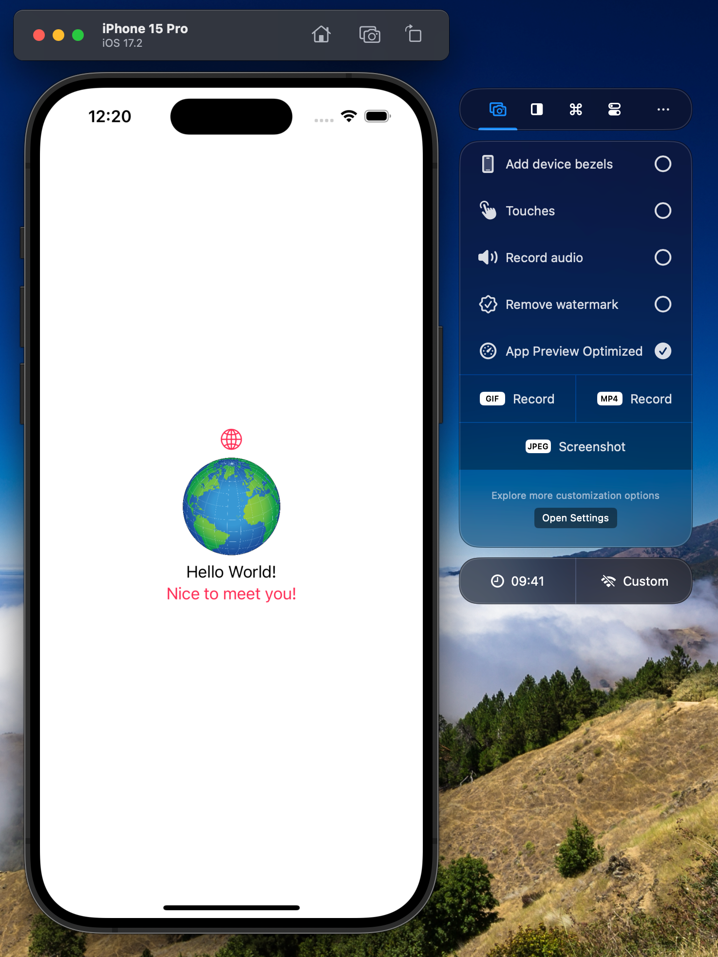
RocketSim
Enhances and simplifies interacting with Xcode simulators. https://www.rocketsim.app/
This a paid app and I am not affiliated or sponsored by the creator in any way, but I feel that it is worth it for what it does. Yearly sub ~$30. Can catch Black Friday sales.
Very extensive feature list on the home webpage.
Walk through highlights on each tab.

Slide 22
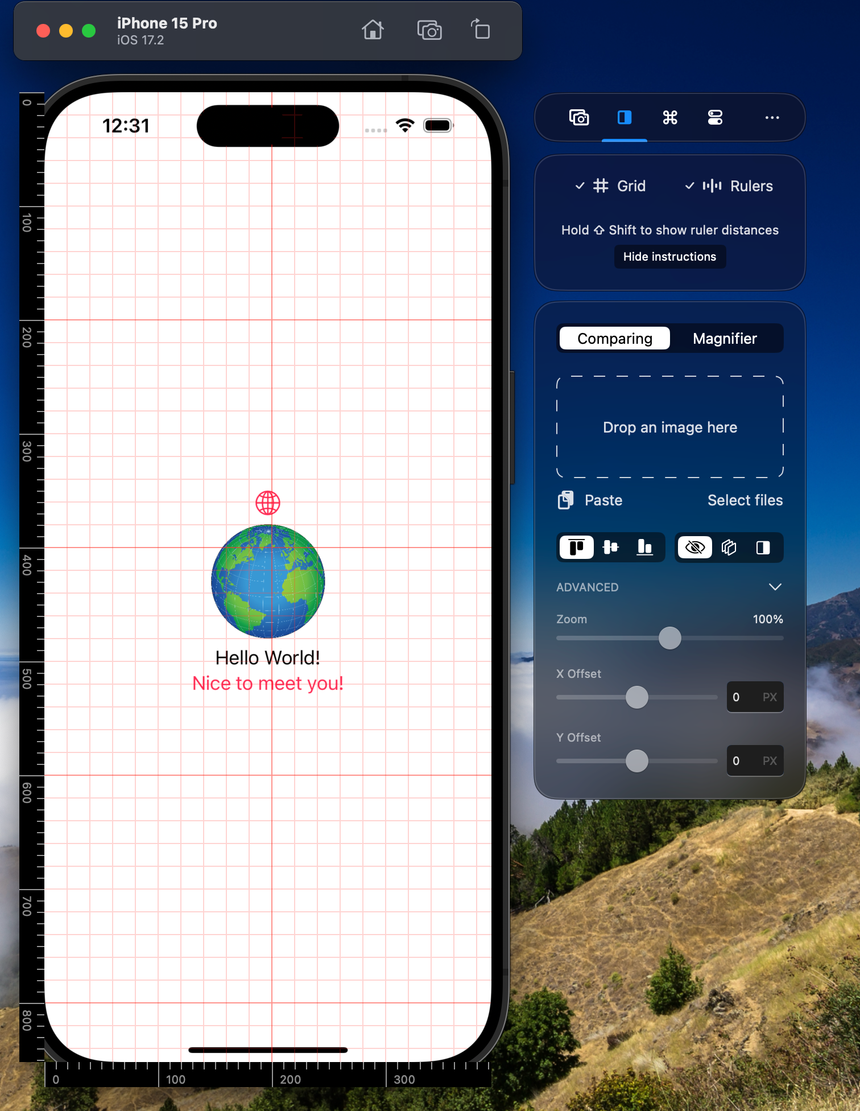
RocketSim
Grids and rulers very handy for aligning elements and checking against designs.
Compare with design image, overlay to see how well the current view matches a design.

Slide 23
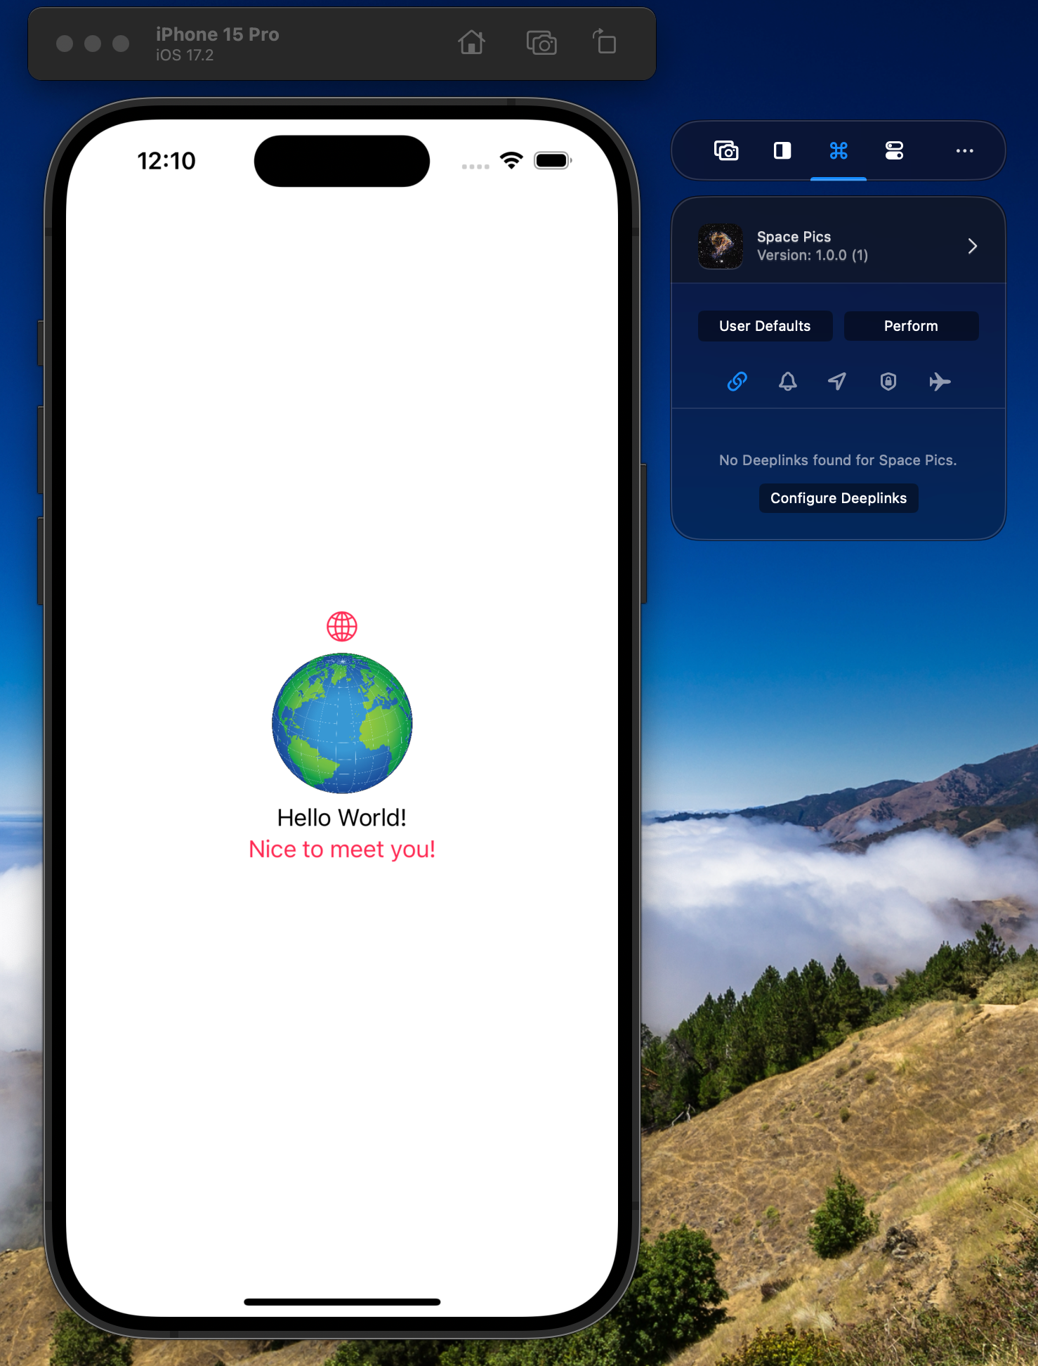
RocketSim
See and change UserDefaults and perform actions on the app like looking at the app file structure and contents, launching with different locales and timezones.
Invoke deeplinks supported by the app.
Send notifications to the app.
Change the location of the simulator device.
Grant and revoke system permissions for the app.
Toggle airplane mode for testing.

Slide 24
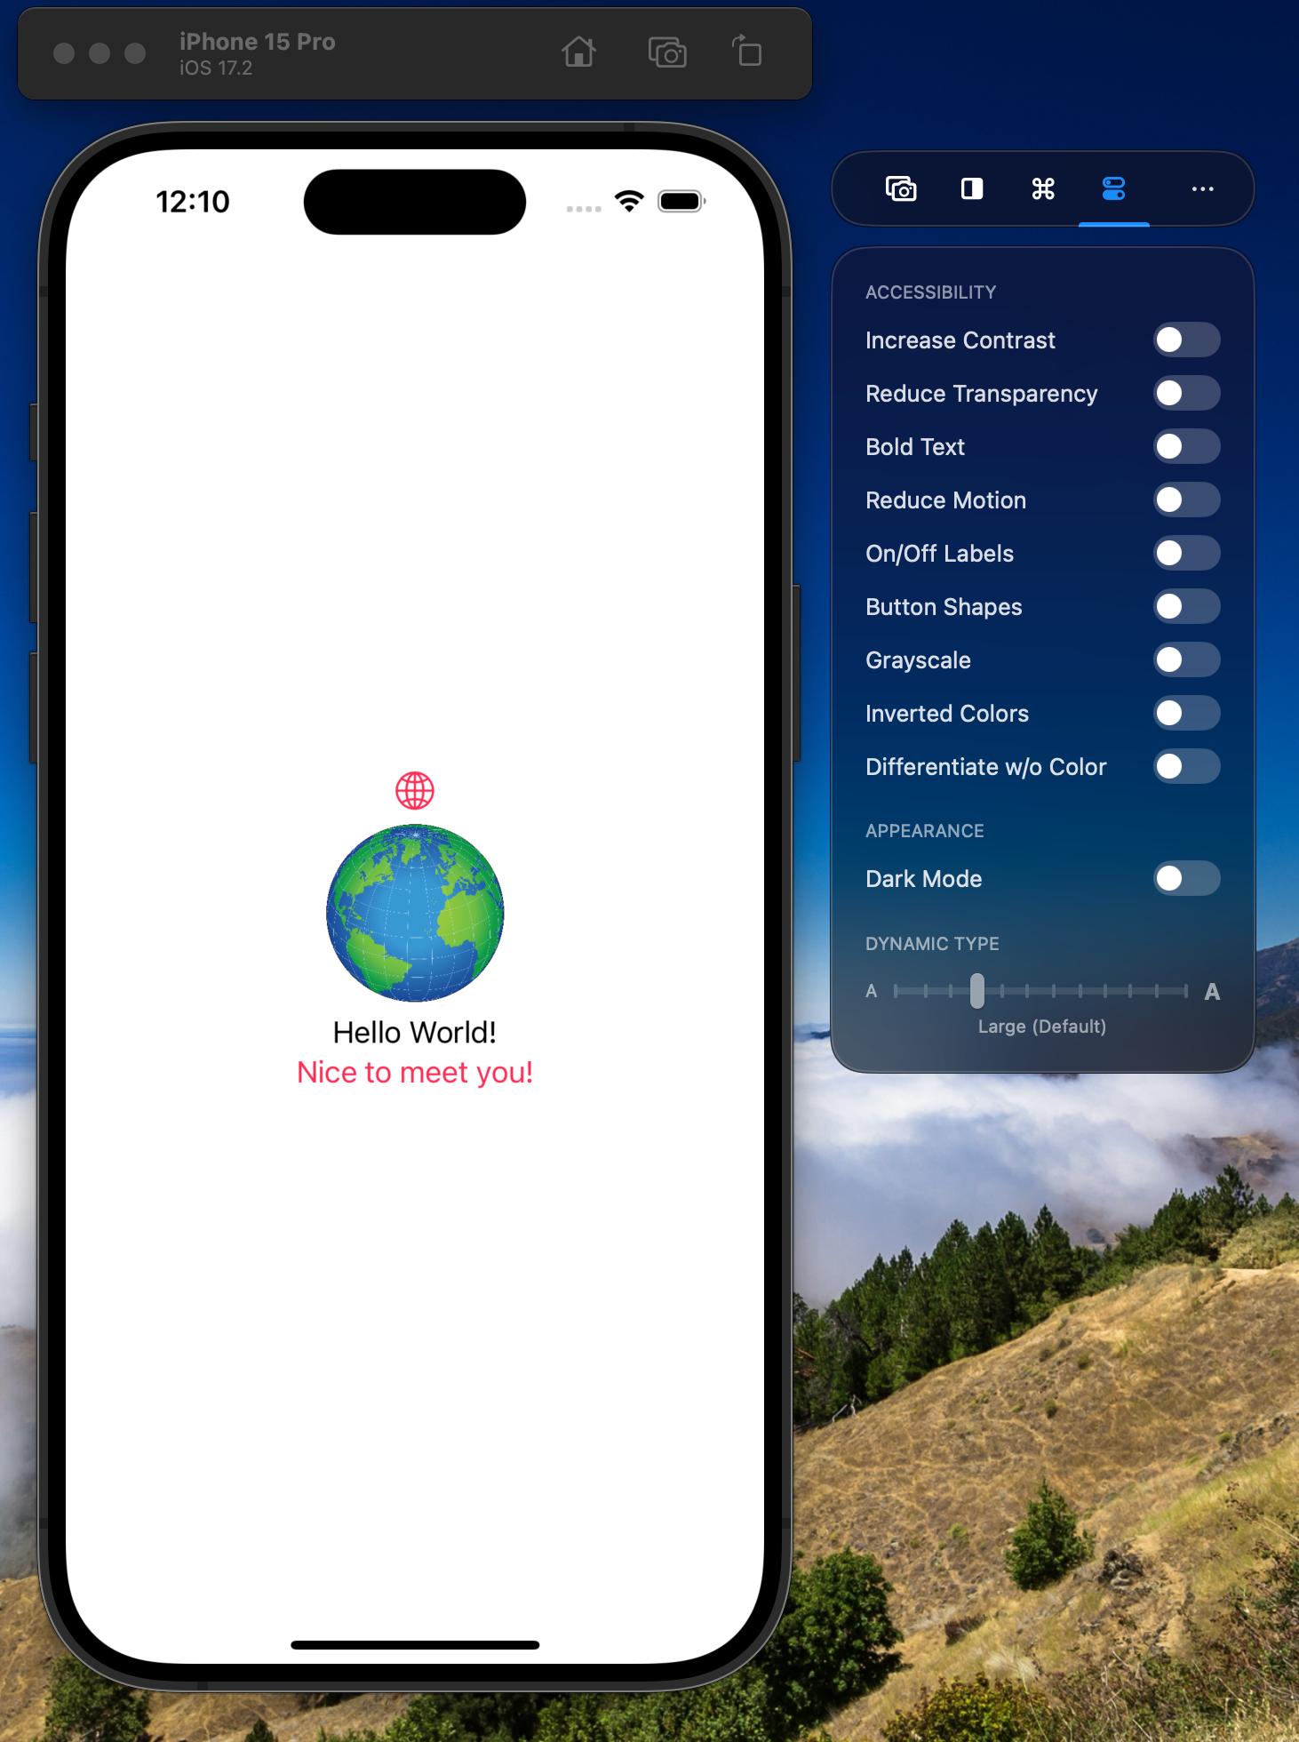
RocketSim
Change several settings to check accessibility concerns.
Change simulator system default appearance between dark and light mode.
Manipulate the simulator dynamic font setting to test how well the app supports font scaling.

Slide 25
More….
Tuist - command line tool that helps you generate, maintain and interact with Xcode projects. This is a contender to replace XcodeGen that I want to investigate. https://tuist.io/
Light Blue app – BTLE development tool
https://apps.apple.com/us/app/lightblue/id557428110
Scan and connect to BTLE devices, view profiles, read/write characteristics and subscribe to notifications.
Emulate different “Virtual Devices” for testing. Blood Pressure, Cycling, Glucose, Heart Rate, Location & Navigation and more.

Slide 26
Questions?

